Slide 1



Slide 2


Slide 3


Slide 4

Understanding the latest shifts in consumer behavior and industry practices
The market analysis reveals significant patterns that indicate how businesses must adapt to meet evolving customer expectations and preferences.

Slide 5

Exploring Market Opportunities with Significant Growth Potential
77% growth potential
Target demographic opportunity
The target demographic shows a remarkable increase in demand, highlighting a vital opportunity for businesses to invest and expand within this emerging market segment effectively.

Slide 6


Slide 7
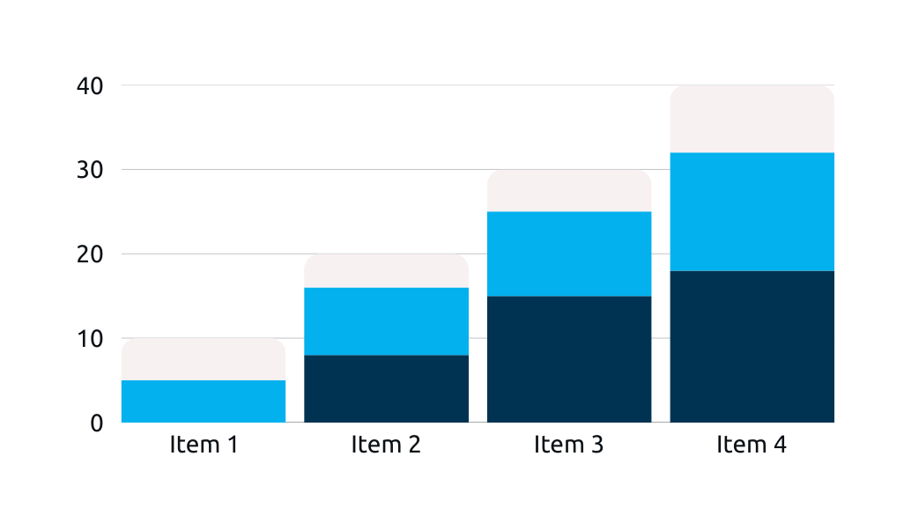

Slide 8

Visualizing our growth trajectory over the next five years
The stacked bar chart illustrates key objectives and milestones, showing projected growth in various sectors and helping us track progress toward our long-term goals effectively.

Slide 9



Happy Client
Great Support
Outstanding Results
“Our experience was fantastic, and we couldn't be happier!”
“The team was incredibly supportive and guided us through every step.”
“The results exceeded our expectations and truly transformed our business.”

Slide 10


